Slide 1

Socio-cultural influences

Slide 2
2.1.c. Ethical and socio-cultural issues in physical activity and sport
Ethics in sport
By the end of this topic you should …
know and understand
  the value of sportsmanship
  the reasons for gamesmanship and deviance in sport.
be able to apply practical examples to these concepts.
LEARNING OUTCOMES

Slide 3
Sportsmanship
Sportsmanship …………….
…. involves behaviour that shows fair play, respect for opponents and gracious behaviour, whether winning or losing.
Showing good sportsmanship means sticking to the rules and regulations.
Sportsmanship shows that you can lose gracefully and win with good humour.
Each sport has its own code of behaviour and ‘sportsmanship gestures’.
Task: how many different displays of sportsmanship, fairness or etiquette can you think of?
Notes:
Photo: © Stock.xchng. http://www.sxc.hu/photo/282937

Slide 4
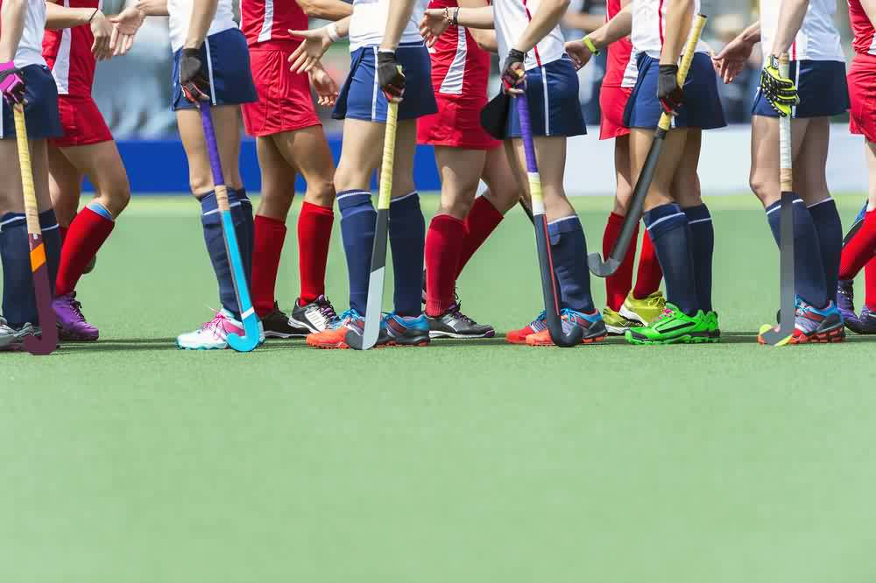
Sportsmanship
Examples of sportsmanship may include:
shake hands with your opponent
thank anyone who has been participating with you or against you
show concern for others, especially when they are injured or under stress
never swear or be abusive
do not stretch the rules to take advantage of someone else
take defeat well and show good humour
do not question officials – accept their decisions
say ‘well done’ to opponents when they do well
taking other people into consideration when participating in exercise – for example, swimming and avoiding colliding with other
do not over-celebrate when you do well – take other people’s feelings into account and avoid arrogance in victory
do not deride the efforts of others – be respectful of others, whatever their ability.
Notes:
Photo: © Stock.xchng. http://www.sxc.hu/photo/282937

Slide 5
Etiquette
Examples of good etiquette may include:
take other people into consideration when participating in exercise – for example swimming and putting away equipment after you use it
not spitting on opponents
avoid colliding with others
drying/wiping fitness equipment after use and not leaving pools of sweat on machines
putting free weights away
replacing divots on golf courses
shouting ‘fore’ when you mishit a shot in golf and it is travelling towards other players
not using your mobile phone whilst playing golf
raking the sand in golf bunkers after you play a shot from them
applaud the new batsman in cricket.
Notes:
Photo: © Stock.xchng. http://www.sxc.hu/photo/282937

Slide 6
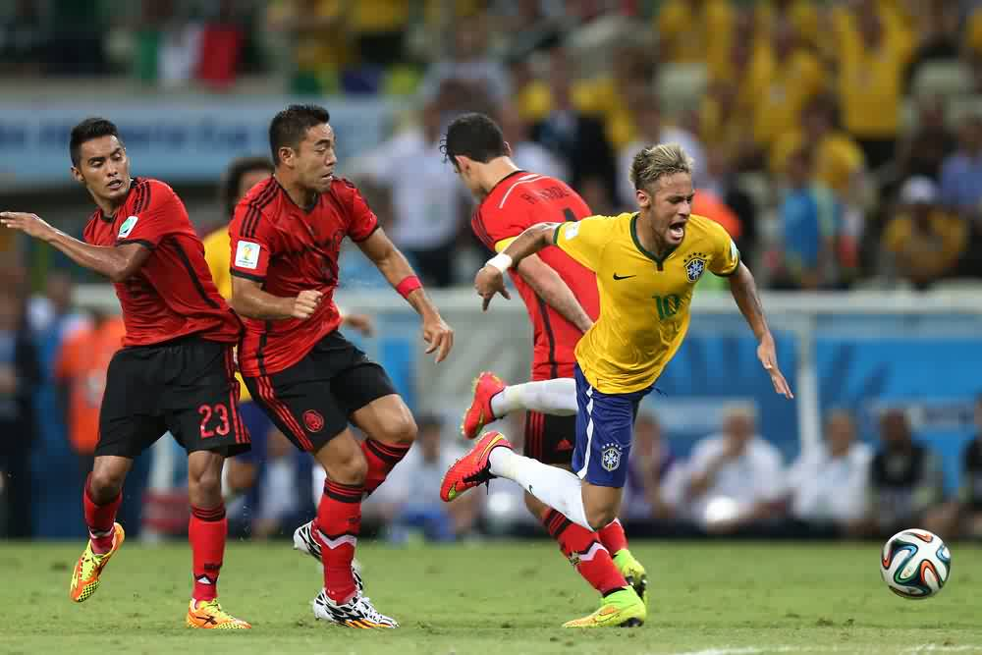
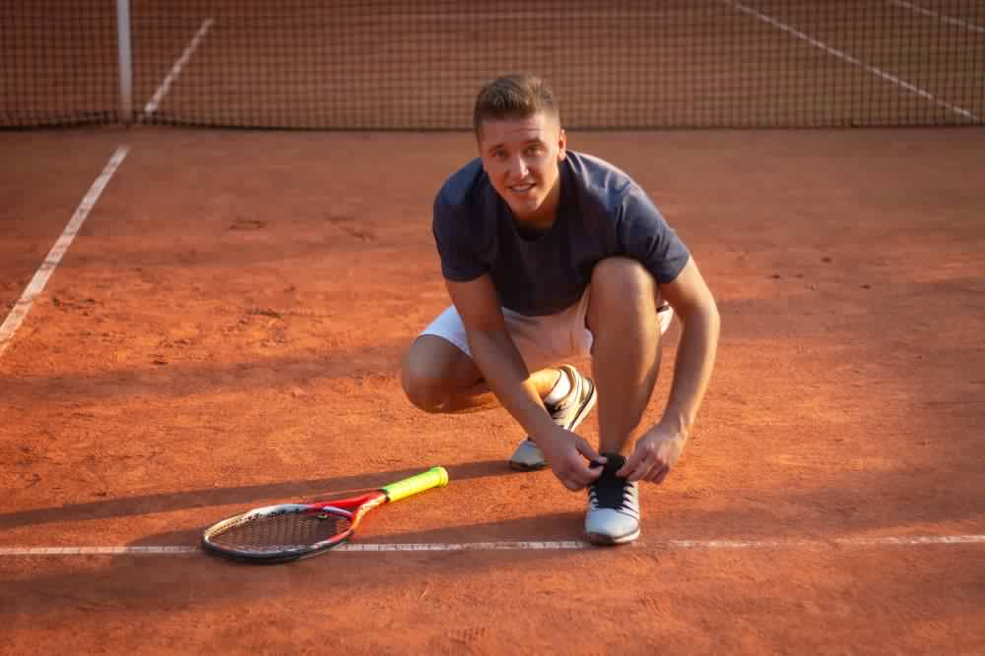
Gamesmanship
- is the use of unethical, although not illegal, methods to win or gain a serious advantage in a game or sport by ‘bending’ the rules
Examples:
sledging to distract batters in cricket
not walking in cricket
coughing or stamping feet to distract shooter at free throws in basketball
grunting in tennis in order to intimidate opponents
distracting penalty takers in football (goalkeepers)
holding to prevent opponents punching in boxing
diving in the 18 yard area to gain a penalty and opponent a ‘yellow card in football
standing over the ball to gain defenders organisation time at free kicks in football
tying your laces to delay receiving a serve (to waste time) in tennis
talking to distract your golf opponent when he/she is taking a shot.
Task: Can you think of any other examples of gamesmanship within sport?
Notes:
Photo: © Stock.xchng. http://www.sxc.hu/photo/282937

Slide 7
Deviance
- involves human behaviour that is against your society’s norms and values.
Behaviour of this kind is often against the rules/laws of the game
Reasons for deviance may include:
the pressure/expectation to win or to gain an (unfair) advantage or pressure from fans/spectators/parents/coaches/team mates
to enhance performance, like bowling with a slightly bend arm to bowl faster
because you are losing
to gain financial reward if you win
a reaction to (poor) decisions by officials
as retaliation/revenge on an opponent who has fouled/injured you earlier in the game
copying others, who may have got away with it earlier in the match or in a previous match
as a result of taking drugs.
Notes:
Photo: © http://forum.cyclingnews.com/viewtopic.php?t=10506&start=40

Slide 8
Sportsmanship
- can be promoted and increased through:
introducing fair play schemes and campaigns
highlighting positive role models
better quality officials and use of technology
development of positive values early on in childhood
punishment for negative behaviour
stricter code of conduct for players, spectators and clubs.
Notes:
Photo: © http://www.theboardgamefamily.com/2010/10/learning-to-lose-gracefully-7-tips/

Slide 9
Sportsmanship or Gamesmanship?
Task: In pairs decide what is Sportsmanship (S) or Gamesmanship (G) from the list below
(the first one has been done for you)
S
1. Apologising to an opponent after the ball hits the net and drops over to win the point in tennis
2. Pretending to be injured at the end of a game to waste some time
3. Shaking hands before and after playing sport
4. Taking an injury break in tennis when you aren’t actually injured
5. Showing concern for others when they are injured
6. Kicking the ball a long distance out of play so it takes longer to retrieve to waste time and allow players to recover
7. Let faster players play through in golf if you are holding them up
8. Appealing for a throw-in even if you know it touched you last
9. Accepting all officials decision without arguing
10. Insulting opponents before they take a shot in cricket to put them off
11. Pulling on an opponent’s shirt when the referee can’t see you
12. Accept defeat and show good humour

Slide 10
Sportsmanship or Gamesmanship?
Task continued:
In pairs decide what is Sportsmanship (S) or Gamesmanship (G) from the list below
13. Deliberate contact in netball when someone is catching a ball
14. Taking longer than usual to serve in table tennis
15. Coughing whilst someone is playing a shot in golf
16. Congratulating another athlete after he has won a 1500m race that you ran in
17. Blocking people when running in the 10,000m race causing them to lose speed

Slide 11
Effects of Gamesmanship and Sportsmanship
Task: Complete the following table by working with a partner
Effect | Sportsmanship or Gamesmanship?
Irritates players and causes retaliation
Can irritate spectators
Increases goodwill
Support of officials strengthens sports reputation
Gives bad example to young people producing negative role models
Admired by players
Admired by spectators
Causes bad feeling and friction
Undermines officials and undermines the sport
Gives good example to young people producing positive role models

Slide 12
2.1.c. Ethical and socio-cultural issues in physical activity and sport
Drugs in sport
By the end of this topic you should …
know and understand the reasons why sports performers use drugs
know the types of drugs and their effect on performance:
  anabolic steroids
  beta blockers
  Stimulants.
give practical examples of the use of these drugs in sport.
know and understand the impact of drug use in sport:
  on performers
  on sport itself.
LEARNING OUTCOMES

Slide 13
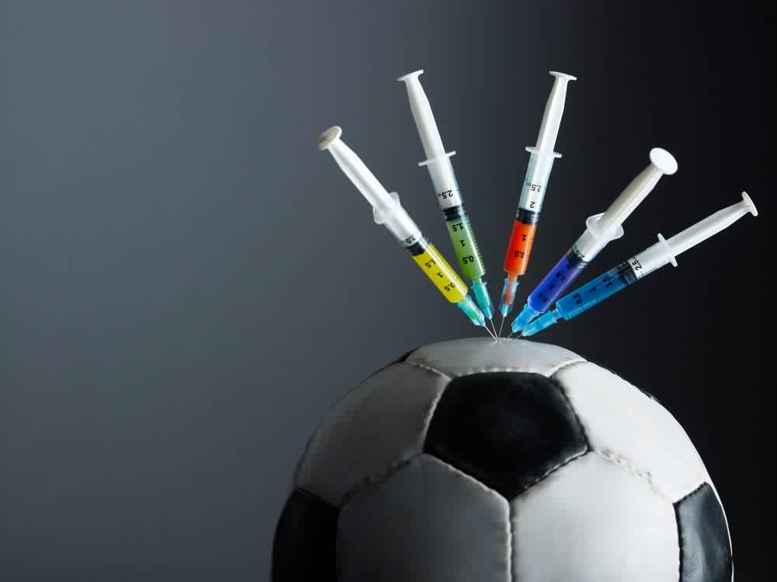
Performance enhancing drugs
Using performance enhancing drugs in sport is an example of DEVIANCE
Definition: A drug is a chemical substance that is used to improve any form of activity performance in humans.
They may also cause some effects that are both unpleasant and unwanted (side effects).
Substances and methods are prohibited in sports for various reasons including:
performance-enhancing effects, which contravene the ethics of sport and undermine the principles of fair participation
health and safety of the athlete - some drug misuse may cause serious side effects, which can compromise an athlete's health. Using substances to mask pain/injury could make an injury worse or cause permanent damage. Some drug misuse may be harmful to other athletes participating in the sport
illegality - it is forbidden by law to possess or supply some substances.

Slide 14
Performance enhancing drugs
Why might athletes use performance enhancing drugs?
to perform better
peer pressure (everyone else is doing it, so why shouldn’t I?)
pressure to become and/or remain the best
pressure from their coach/trainer
financial benefits that come with being the best
to improve physically
  increase strength
  improve aggression
  have more energy
  be able to control emotions more easily.

Slide 15
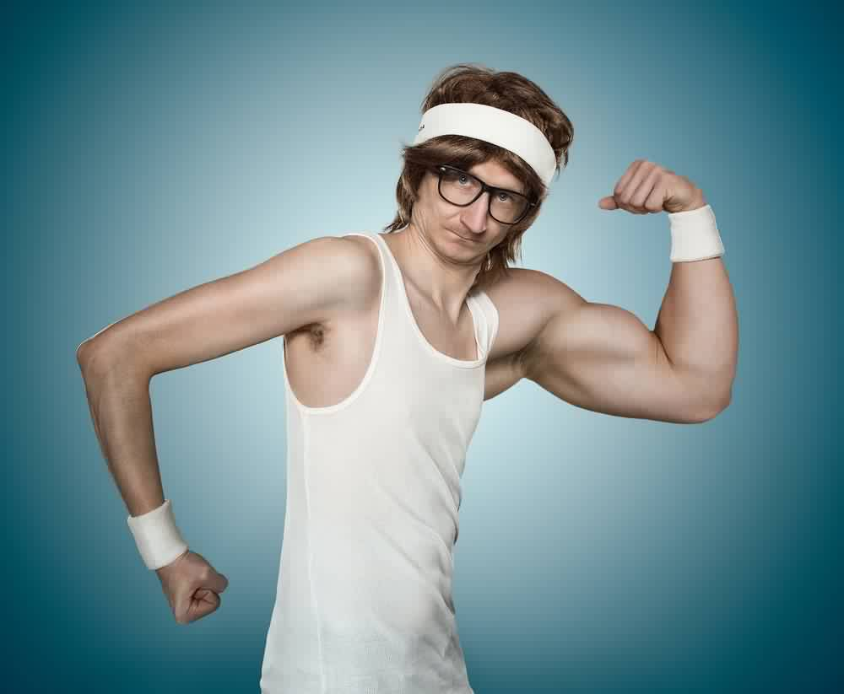
Performance enhancing drugs
Anabolic Steroids
Definition: A drug that mimics the male sex hormone testosterone which promotes bone and muscle growth
What do they do? (why use them?)
Anabolic Steroids increase muscle mass and develop bone growth, thereby increasing the athletes strength whilst at the same time allowing the athlete to train harder and recover quicker.
Desired effects | Negative side effects | Sports performers who might take these
Quicker recovery Train harder and longer Muscular hypertrophy Increased aggression | Liver and kidney damage High blood pressure Acne Reduced sperm count in men Development of breasts in men Facial hair growth, baldness and deepening of the voice in females Increased aggression | Sprinters Long jumpers Boxers ANY EVENT/POSITION THAT REQUIRES POWER

Slide 16
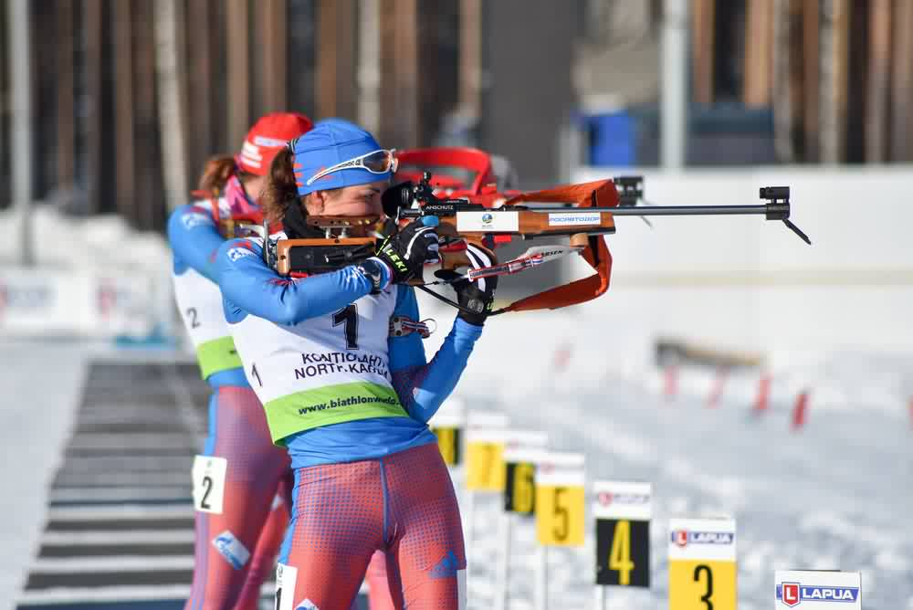
Performance enhancing drugs
Beta Blockers
Definition: A drug that is used to control the heart rate and have a calming and relaxing affect
What do they do? (why use them?)
in medicine, commonly prescribed for people with heart problems as their main function is to maintain a low heart rate
reduce stress and anxiety levels
can help sports where precision and a steady hand are needed (e.g. archery/shooting/snooker/golf).
Desired effects | Negative side effects | Sports performers who might take these
Reduces heart rate Keeps hand steady Reduces the effect of adrenaline | Dizziness Nausea Drowsiness/fatigue Headache Slow heart beat | Archery Shooting Any sports where performers need a steady hand and fine motor control

Slide 17
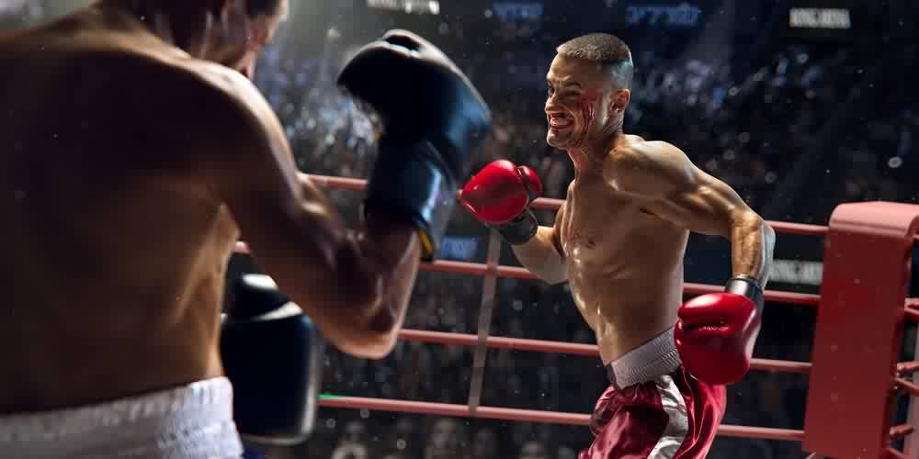
Performance enhancing drugs
Stimulants
Definition: A drug that has an effect on the central nervous system, such as increased mental and/or physical alertness
What do they do? (why use them?)
second most commonly used drugs in sport and include amphetamines, ephedrine and cocaine, as well as nicotine and caffeine
they increase alertness, enabling people to think more quickly by stimulating the central nervous system (CNS)
helps to overcome tiredness but also offsets the negative affects of lactic acid build up within the working muscles.
Desired effects | Negative side effects | Sports performers who might take these
Make athletes more alert Masks fatigue Quick reactions | Heart failure Addictive | Sprinters Boxers Any event/sport which requires a quick start or explosive push

Slide 18


Advantages and disadvantages of taking performance enhancing drugs for the performer
Advantages | Disadvantages
Increased chances of success
Fame
  Olympic/World/National champion
Athletes would be on an even playing field as ‘others’ are taking the drugs already
Wealth
Gain world records.
It is cheating and immoral
There are too many associated health risks
Fines and bans for those caught
Significant reputation damage
Loss of friends/team mates.

Slide 19
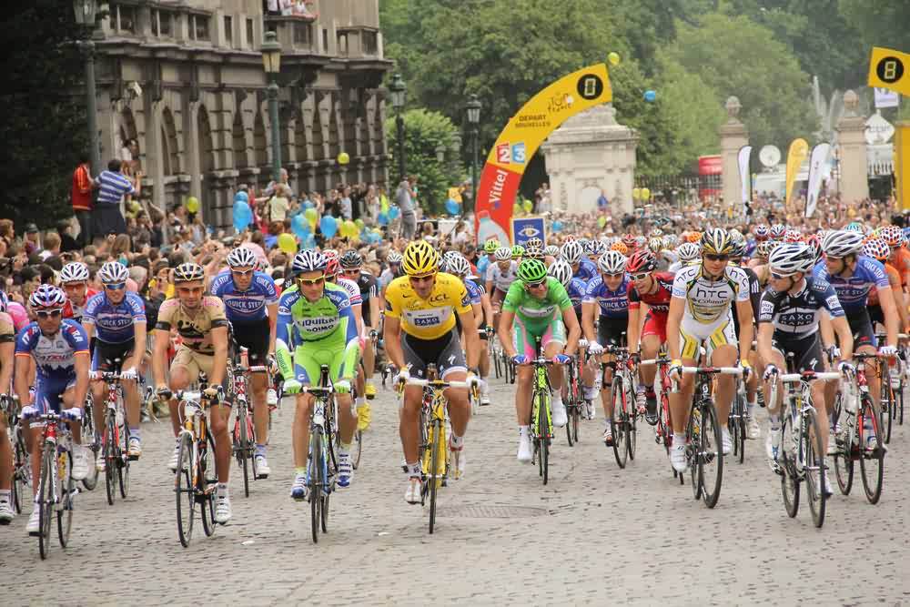
Disadvantages to Sport
The International Olympic Committee and other organisations work hard to eliminate the problem of drug taking. Below is a summary of the reasons why.
Disadvantages:
reputation – a sport can become known for cheating and may affect young people taking it up
credibility – performance will be difficult to believe and will affect the number of spectators.

Slide 20
Data, analysis and evaluation
The table below shows data from the World Anti-Doping Agency.
Year | Sport | Number of samples taken | Total positive tests found
2004 | Athletics | 19,991 | 229
2005 | Athletics | 20,464 | 342
2006 | Athletics | 19,781 | 315
2007 | Athletics | 23,305 | 304
2008 | Athletics | 26,984 | 361
2009 | Athletics | 26,593 | 398
2010 | Athletics | 25,013 | 438
Task: what trends do you notice in the data? How could this problem be tackled?

Slide 21
2.1.c. Ethical and socio-cultural issues in physical activity and sport
Violence in sport
By the end of this topic you should…
know and understand the reasons for player violence
be able to give practical examples of violence in sport.
LEARNING OUTCOMES

Slide 22
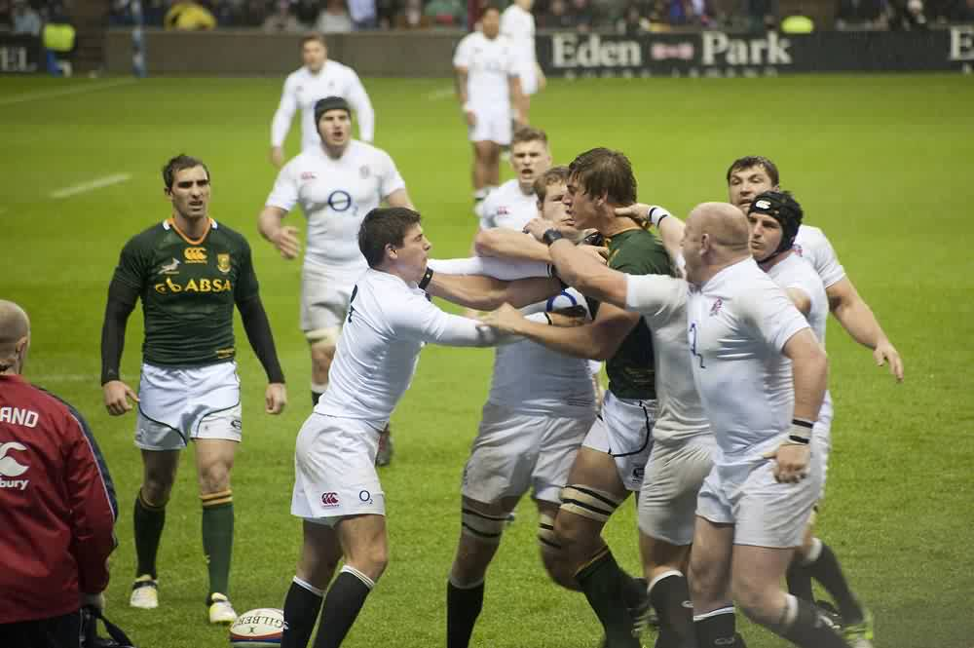
Violence
Controlled aggression is a fundamental part of many sports.
Sometimes, however, this spills over into an uncontrolled situation where serious physical injury can be caused.
Violent behaviour can be caused by the following reasons:
pressures of the media
frustration as a result of losing
sponsorships deals
pressure from spectators/taunting from crowd/opponents
as physical retaliation/as a reaction to a challenge/tackle
over arousal during the game
annoyed by poor decisions by officials
to gain an advantage/to hurt your opponent controlled aggression may be required for effective play
as a result of the influence of drugs
we copy others.
Task: Why do players show acts of violence during sporting contests?
Notes:
Photo: © http://www.adelaidenow.com.au/news/opinion/sean-edwards-sport-owes-us-truth-or-our-money-back/story-e6freabc-1226585392838

Slide 23
Violence
Strategies to control violence or aggression:
calm down by relaxing or by concentrating on your own performance in the game or activity. Focussing attention on the job in hand is sometimes called channelling aggression
avoid situations that might make you angry or aggressive for example by walking away from trouble or trying a new position on the field of play
remove yourself completely from the situation for example a basketball coach may substitute an aggressive player to calm down
enjoy praise for not being aggressive. Your coach may well praise the fact that you have been a forceful, effective player, but you have not been aggressive and given away territory
recognise others who are successful (role models) but who do not resort to aggression. Most successful sportspeople are not aggressive but are assertive
punishment or fear of being punished may well control aggression. Often fines are used or a player may be dropped from the team
recognise that you have a position of responsibility. Aggression could let the rest of the team down
anger management. Try to identify what makes you angry and to avoid the triggers to anger. You may learn to deal with your feelings early on rather than waiting for your anger to build up out of control
breathing exercises. Relax in your mind and body with deep, controlled and slow breathing. This can affect your heart rate, which will decrease the steadier your breathing, and then you will be able to feel calmer.
Notes:
Photo: © http://www.adelaidenow.com.au/news/opinion/sean-edwards-sport-owes-us-truth-or-our-money-back/story-e6freabc-1226585392838

Slide 24
Data, analysis and evaluation
The table below shows the disciplinary records from previous FIFA World Cup tournaments.
 | 2006 | 2010 | 2014
Total number of yellow cards | 345 | 261 | 187
Average yellow cards per match | 5.39 | 4.08 | 2.92
Total number of red cards | 28 | 17 | 10
Average red cards per match | 0.44 | 0.27 | 0.16
TASK: what trends do you notice in the data? What are some of the reasons for this?

Slide 25
Apply it!
Ethical and sociocultural issue in sport
Why is important that sportsmanship is still encouraged in sport today?
Explain the following categories of performance enhancing drugs:
Anabolic Steroids, Stimulants & Beta Blockers.
Why are athletes tempted to use performance enhancing drugs?
Discuss the possible reasons for player violence in sport.
Notes:
Photos by: LOCOG

Slide 26
OCR Resources: the small print
OCR’s resources are provided to support the delivery of OCR qualifications, but in no way constitute an endorsed teaching method that is required by the Board, and the decision to use them lies with the individual teacher. Whilst every effort is made to ensure the accuracy of the content, OCR cannot be held responsible for any errors or omissions within these resources.
Our documents are updated over time. Whilst every effort is made to check all documents, there may be contradictions between published support and the specification, therefore please use the information on the latest specification at all times. Where changes are made to specifications these will be indicated within the document, there will be a new version number indicated, and a summary of the changes. If you do notice a discrepancy between the specification and a resource please contact us at:
resources.feedback@ocr.org.uk.
© OCR 2018 - This resource may be freely copied and distributed, as long as the OCR logo and this message remain intact and OCR is acknowledged as the originator of this work. OCR acknowledges the use of the following content:
Please get in touch if you want to discuss the accessibility of resources we offer to support delivery of our qualifications: resources.feedback@ocr.org.uk
4 > Hockey_players / Corepics VOF / Shutterstock.com 6 > Football / AGIF / Shutterstock.com / ED 6 > Tennis / Bakhur Nick / Shutterstock.com 12 > Syringes / Diego Cervo / Shutterstock.com 14 > Tennis_nerd / rangizzz / Shutterstock.com | 15 > Shooter / Julia_Sadykova / Shutterstock.com / ED 16 > Boxers / Oleksii Sidorov / Shutterstock.com 18 > Cyclists / Ahmed Akl / Shutterstock.com / ED 21 > Football / Neil Balderson / Shutterstock.com / ED

